Slide 1
Test Manager tool “Prepare and Perform Verification and Validation”

Slide 2
Why need for change?
Missing efficient solution (AET/RT, Safety)
Improved work flow
Changing surrounding (GHOST, GTDM, TCP, PROTOM, VLT...)
Continious improvement of methods (PVT, AET/RT, Safety)
Platform/markets, dynamic test sequences
More info about test (test components, project mix, before/during/after)
Test PAD’s for improved efficiency
”EOL” according VIT application review (RDM, eFACTS, PVT Manager)

Slide 3
PIM and CR – adressing similar need of better tool support
PIM PVT step 2 (approved budget), but only focus for PVT
CR 12-106 (pre study) – Axel Olsson, focus for AET/RT
CR VASP – Magnus Ström, focus for safety testing
Examples of need
Test procedure handling (test case/routine/sequence)
Test Execution Interface in the vehicle for drivers
Test Follow-up
Enabling search for data and tests

Slide 4
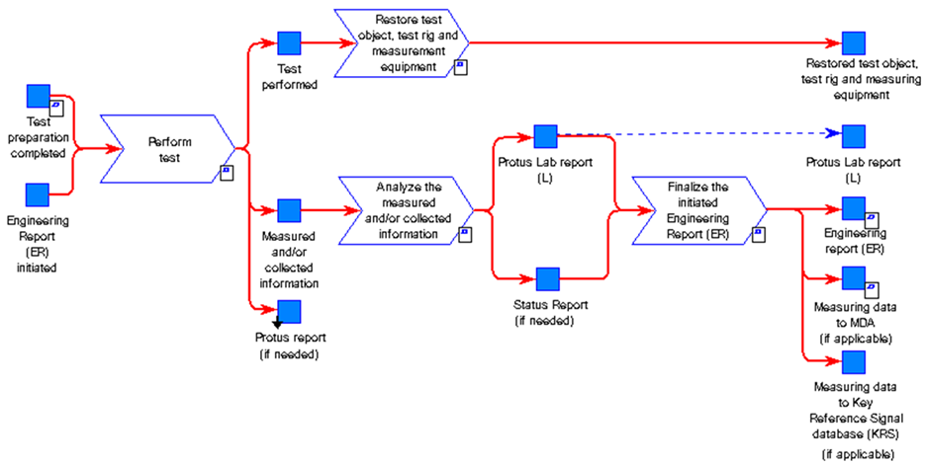
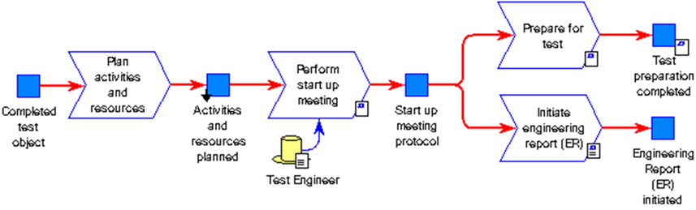


AS-IS
Up- date
Re-plan
Example
PM Planning sheet
Dept. Planning sheet
Prepare test procedure
Execute test
PROTUS
RDM/Axxos eFACTS PROTUS
Data upload
Prepare test object
RDM eFACTS
STEF (replace MDA?)
BOSS
Resource planner
FVV Test Manager
Test follow-up
PROTUS
Test Vehicle Viewer
GHOST
V&V DB
Excel
Information board
Update
Collaboration platform – meta data keeper or only a search in other systems using TeDM?
Missing
No change?

Slide 5
TO-BE
Test Manager and Test Collaboration Platform Concept
Test Collaboration Platform
GTDM Scope
Up- date
Re-plan
BOSS
GHOST
Test Manager
Incl Test Module?
HPG Planning tool
AXXOS
V&V plan
Defines acceptance criteria and methods. Selecting test objects and create time plan.
Test request
Based on V&V plan the test should be initiated e.g. n-8 weeks before the actual test should start.
In order to secure parts, material, resources and test object build. Quotation secured.
Plan activities and resources All needed resources and budget is secured.
Prepare for test The test object is
e.g. prepared with measurement equipment. The test procedure and method is prepared and secured.
Analyze/Reporting
Perform test Measurement systems and tools are efficient and control and give support during the test execution. E.g. test procedure, KPI, progress and status is available (results/running/faults found).
PROTUS
Vehicle Logging Tool
Data handling
Results and data are analyzed, documented and published. The data is also made available to upload for analysis or as input for future testing.
GHOST incl Test Module ?
Data information exchange
”Test Collaboration Platform”

Slide 6
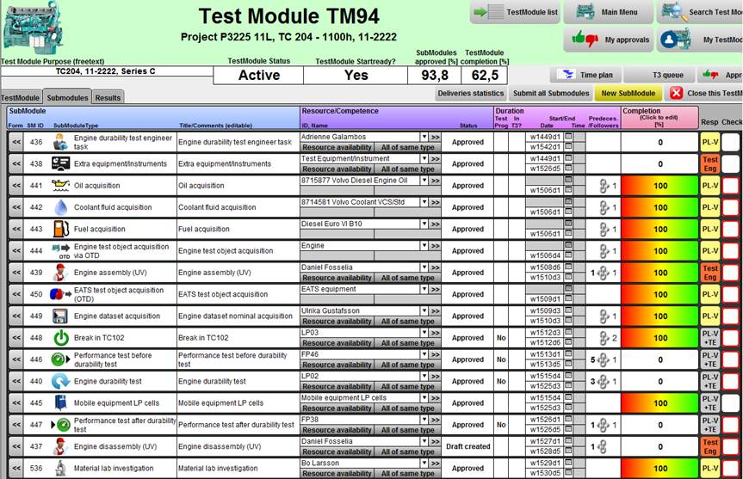
Test Module example - Powertrain

Slide 7
Vehicle Logger Tool – early draft (eFACTS/RDM)

Slide 8
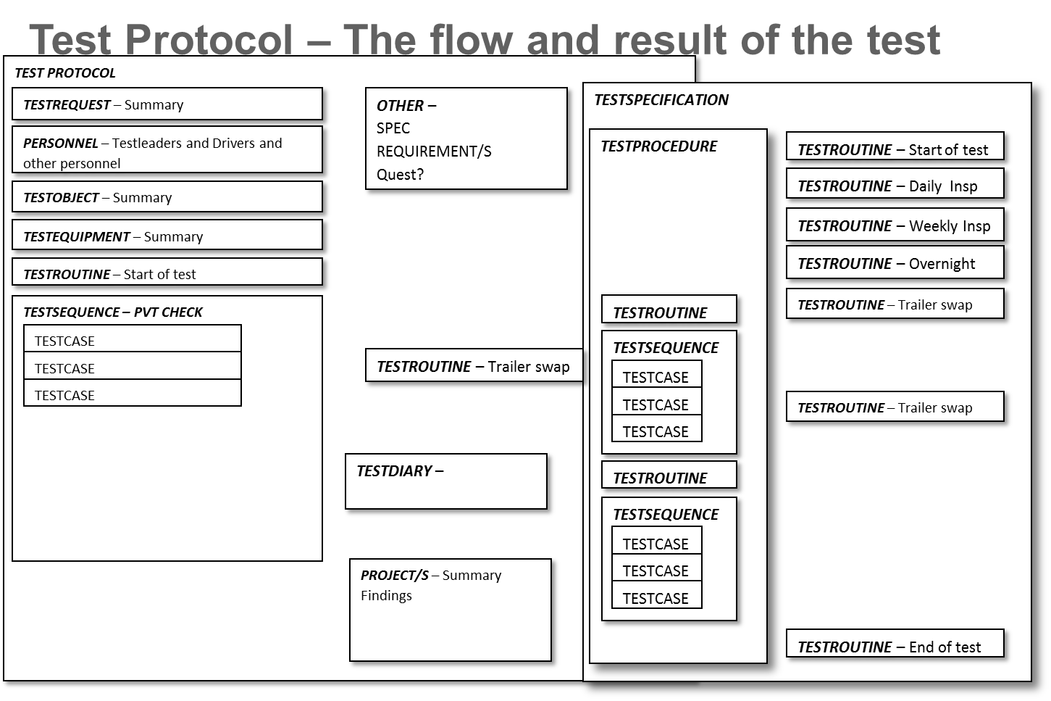
PIM PVT step 2 – meta data model

Slide 9
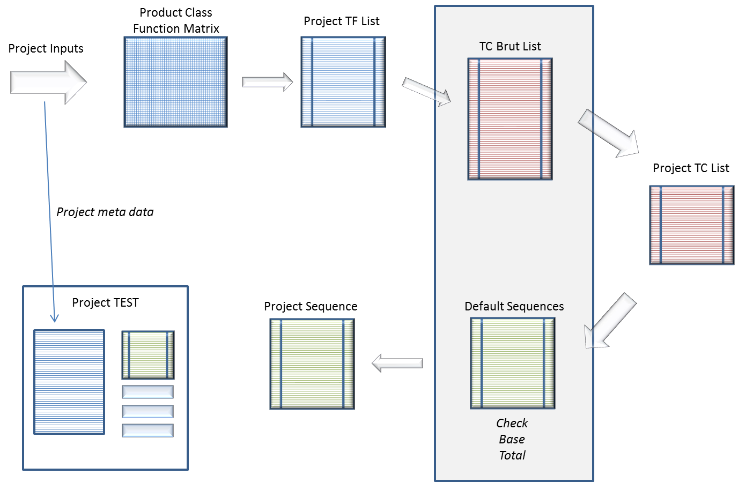
Example of project/test need

Slide 10
TO-BE
Up- date
Re-plan
Perform Collect
Analyze, Document & Share
Define
Plan
Prepare
V&V plan:
Defines acceptance criteria and methods. Selecting test objects and create time plan.
Test request:
Based on V&V plan the test should be initiated e.g. n-8 weeks before the actual test should start.
In order to secure parts, material, resources and test object build. Quotation secured.
E.g. n-2/n-1 weeks follow-up with all stakeholders that delivery is secured.
Plan activities and resources: All needed resources and budget is secured. E.g. n-2/n-1 weeks follow-up with all stakeholders that preparation is secured.
Prepare for test: The test object is
e.g. prepared with measurement equipment. The test procedure and method is prepared and secured. E.g. n-2/n-1 weeks follow-up with all stakeholders that preparation is secured.
Perform test: Measurement systems and tools are efficient and control and give support during the test execution. E.g. test procedure, KPI, progress and status is available (results/running/faults found).
Data handling:
Results and data are analyzed, documented and published. The data is also made available to upload for analysis or as input for future testing.
Data information exchange e.g. meta data stored and test is visual.
Resources:
Driver, mechanics, area, tools, test leader
A plan for product verification and validation activities, virtual and physical, including due dates and responsibilities, assuring project compliance to the stakeholders targets and expectations and the product requirements stated in the requirement specification. When choosing the activities in the Verification and Validation plan the identified project risks should be considered.

Slide 11
Test preparation
Prepare
Equipment preparation
Axxos - for measurement equipment
RDM – for remote data upload
eFACTS – if fault logging
Special/different tools to configure equipment
PROTUS – for test vehicles
Test case preparation
E.g. brake – GDI
E.g. RT/AET – Word/Excel → Need database
E.g. PVT – database
E.g. Safety – Excel → Need database

Slide 12
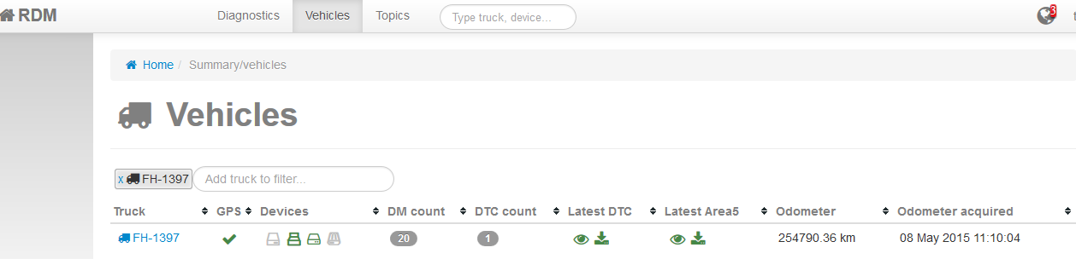
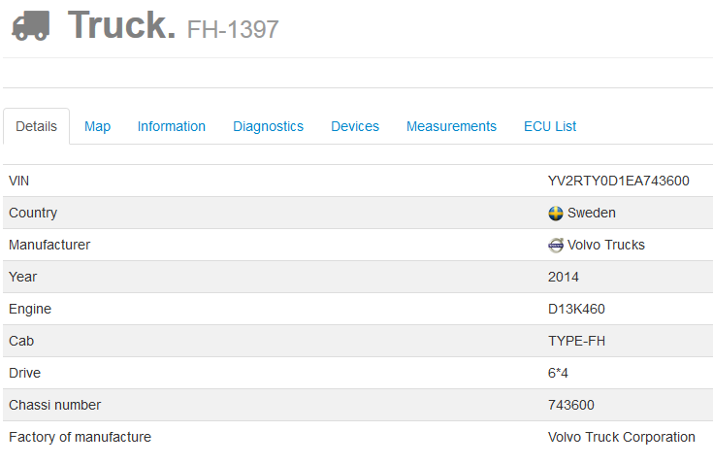
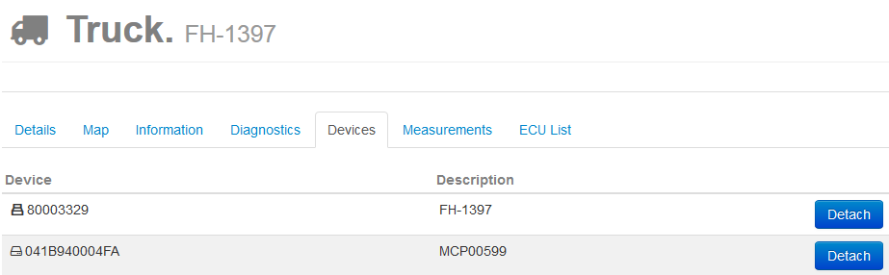
RDM – logger/vehicle binding
Prepare

Slide 13
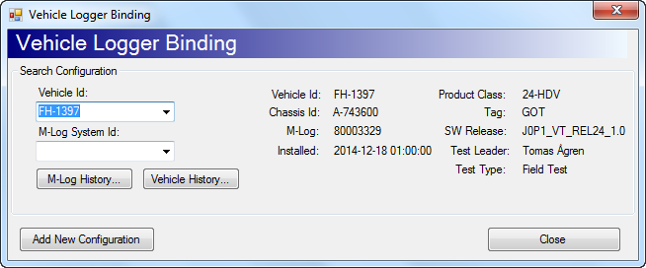
eFACTS – logger/vehicle binding
Prepare

Slide 14
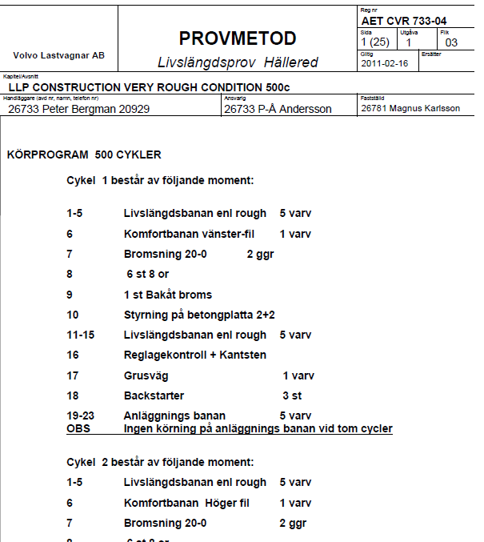
Example AET/RT test code
Prepare

Slide 15
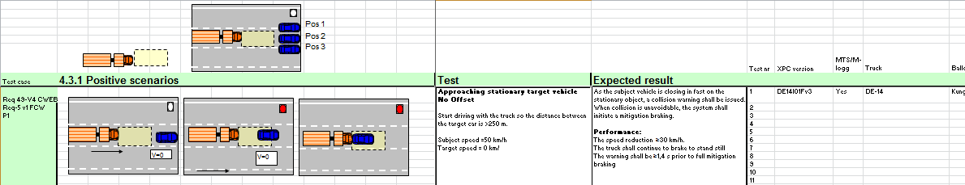
Example – safety test code
Prepare

Slide 16
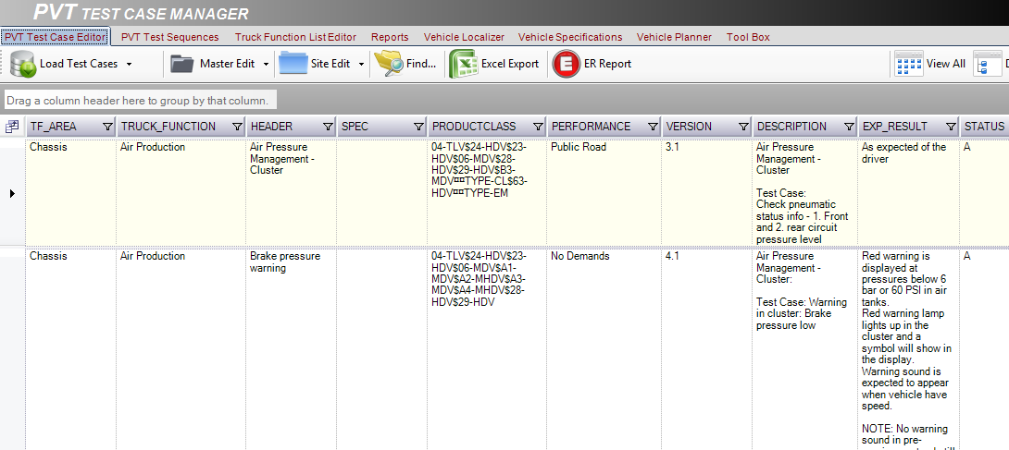
Example PVT today – test cases
Prepare

Slide 17
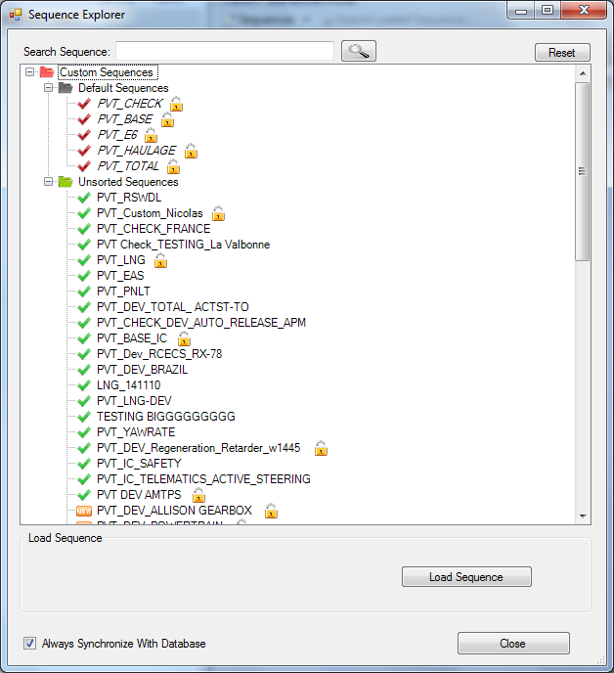
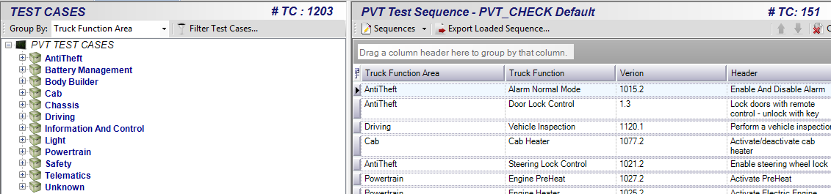
Example PVT – test sequences
Prepare

Slide 18
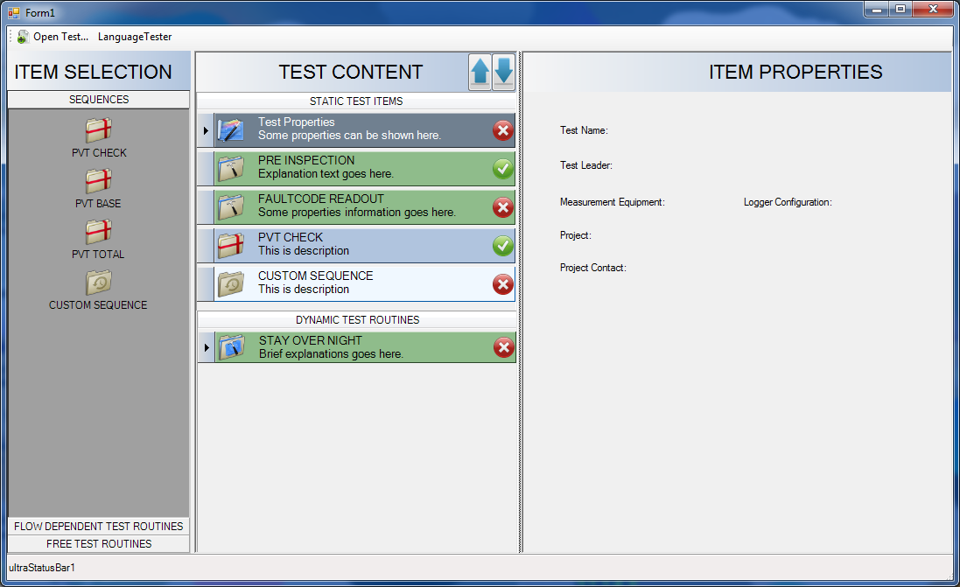
FVV Test Manager? PIM PVT step 2
Prepare
ToBe Example

Slide 19
TO-BE
Up- date
Re-plan
Perform Collect
Analyze, Document & Share
Define
Plan
Prepare
V&V plan:
Defines acceptance criteria and methods. Selecting test objects and create time plan.
Test request:
Based on V&V plan the test should be initiated e.g. n-8 weeks before the actual test should start.
In order to secure parts, material, resources and test object build. Quotation secured.
E.g. n-2/n-1 weeks follow-up with all stakeholders that delivery is secured.
Plan activities and resources: All needed resources and budget is secured. E.g. n-2/n-1 weeks follow-up with all stakeholders that preparation is secured.
Prepare for test: The test object is
e.g. prepared with measurement equipment. The test procedure and method is prepared and secured. E.g. n-2/n-1 weeks follow-up with all stakeholders that preparation is secured.
Perform test: Measurement systems and tools are efficient and control and give support during the test execution. E.g. test procedure, KPI, progress and status is available (results/running/faults found).
Data handling:
Results and data are analyzed, documented and published. The data is also made available to upload for analysis or as input for future testing.
Data information exchange e.g. meta data stored and test is visual.
Resources:
Driver, mechanics, area, tools, test leader
A plan for product verification and validation activities, virtual and physical, including due dates and responsibilities, assuring project compliance to the stakeholders targets and expectations and the product requirements stated in the requirement specification. When choosing the activities in the Verification and Validation plan the identified project risks should be considered.

Slide 20
Perform, Collect and Follow-up
Perform
Test Vehicle Viewer
Test status and progress
KPI
PROTUS
Paper
Km/cycles
Fuel
Driver report
Information board
Weather
Trucks running
Work shop area
Trailer
Locate truck

Slide 21
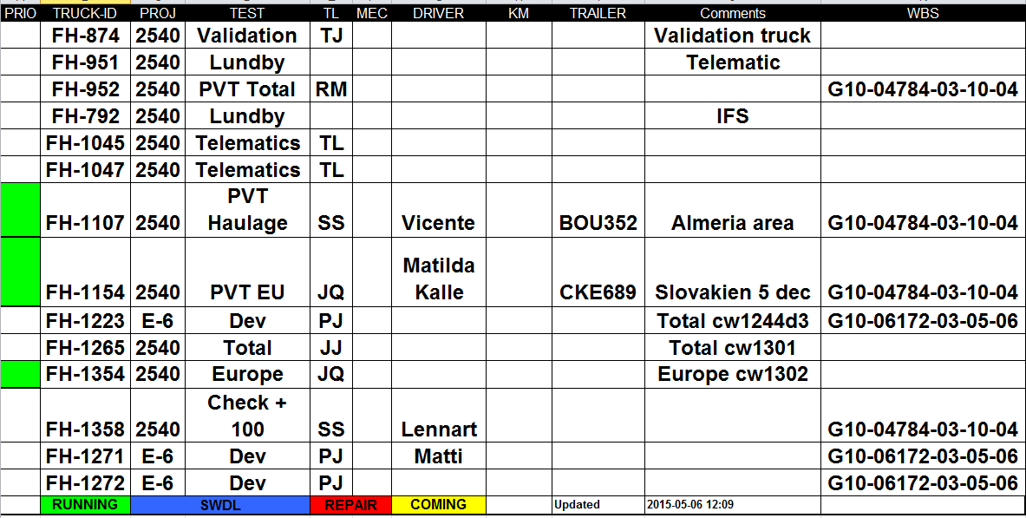
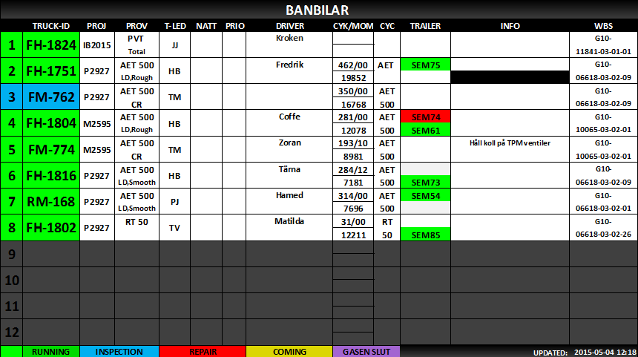
Information board – info in work shops
Perform

Slide 22
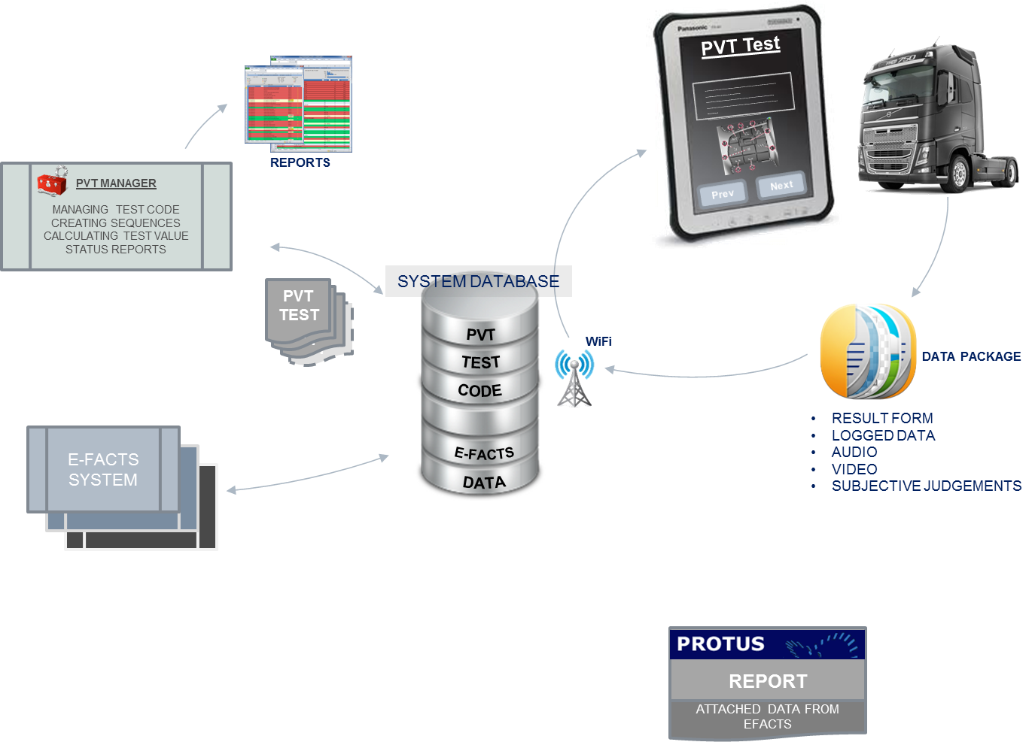
PIM PVT step 2 – Test Management Flow
Is NOT addressing:
- Resource planner
- Information board

Slide 23
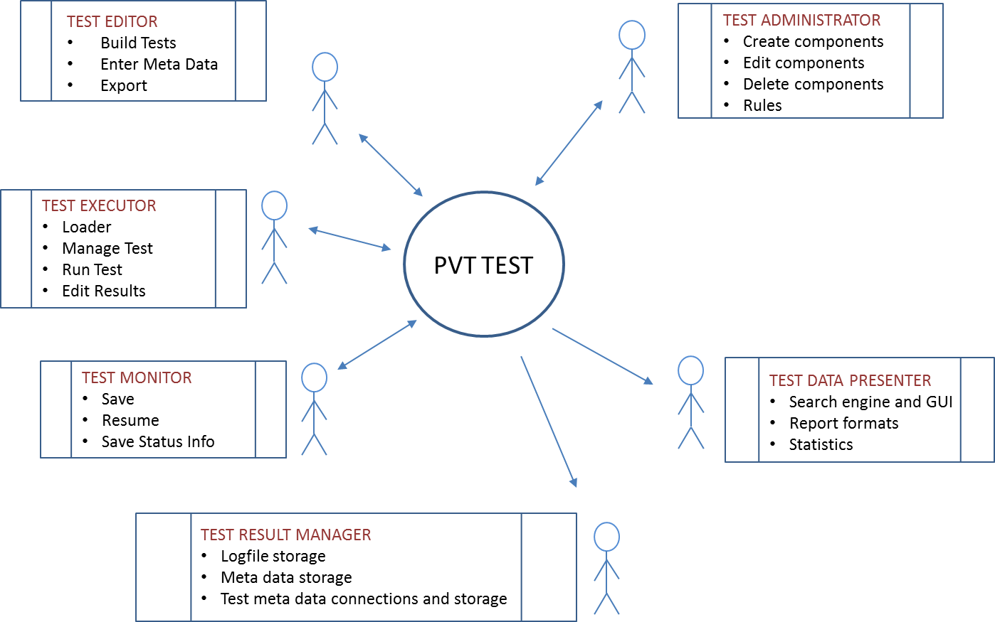
PIM PVT step 2 - Actors

Slide 24
GUI example – in vehicle
Shortcut Menu
TestFlow
(optional)
Bound items
WorkSpace
Free items
InfoBar

Slide 25
Home page
Vehicle: FH-123
Test: AET500
Driver: Kalle Karlsson
Perform
Test
Start new
ToBe Example
Pause
Continue
Switch driver
Information
Important
Vehicle
Manual
Country specific
Dynafleet
Solved issues
PROTUS reports
Test
Project
Statistics
Issue report
Read DTC
Status
Picture Video
Service
Cycles/km fluids
Read HW/SW

Slide 26
Fault report
Home/back
Example new PVT/AET/RT
TC OK
Perform
Test case
Header info
Actual/Target speed
ToBe Example
Test case
Header info
Driver Manual
Track
Description
Expected result
Test picture
Text box
Text box
If expanded
Map
Test case
Header info
Track
Next
Test case
Header info
Track
Important messages

Slide 27
TC failed
Home/back
Example new VASP
TC OK
Perform
Actual speed
ToBe Example
No offset, 50km/h - 0 km/h
Description
Expected result
Approaching stationary target vehicle
Start driving with the truck so the distance between the target car is >250 m.
No Offset
Subject speed =50 km/h
Target speed = 0 km/h
As the subject vehicle is closing in fast on the stationary object, a collision warning shall be issued. When collision is unavoidable, the system shall initiate a mitigation braking.
Performance:
The speed reduction ≥30 km/h.
The truck shall continue to brake to stand still
The warning shall be ≥1,4 s prior to full mitigation braking
Map
Comment
Text box
TC adjusted

Slide 28
Fault report
Home/back
Save Report
Perform
ToBe Example
Error
Abort
Validation
TC related
Record Audio
Important messages

Slide 29
Error
Perform
Cause list
Function error
11 - Knicking & Thudding Noise
12 - Grating Noise
13 - Howling Noise
14 - Squeaking Noise
15 - Wind Noise
16 - Vibration
17 - Imbalance
18 - Poor Ride Comfort
Request Measures
ToBe Example
Truck Function Area
Noise/vibration
Truck Function
Leakage
Interference
Type of functional error
Electrical Faults
Malfunction
Stability
Assembly Faults
21 - Gas/Air leakage
22 - Fuel Leakage
23 - Lubricanting Oil Leakage
24 - Water Leakage
25 - Hydralic Oil Leakage
27 - Exhaust Fumes
29 - Other Fluids
Don’t respond
Freeze
Deformation
Restarts
Corrosion
Surface Treatment
Occurance
PROTUS points

Slide 30
Validation – driver opinion
Perform
Readable
Flickering
Missing
Logic
Text
Response time
ToBe Example
Inconsistancy
Indication
Start-up time
Warning
Sound
Feature
Truck Function Area
Truck Function
Occurance
Validation points

Slide 31
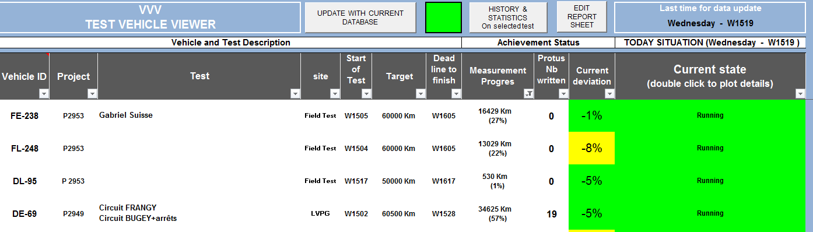
Test Vehicle Viewer
Follow-up

Slide 32
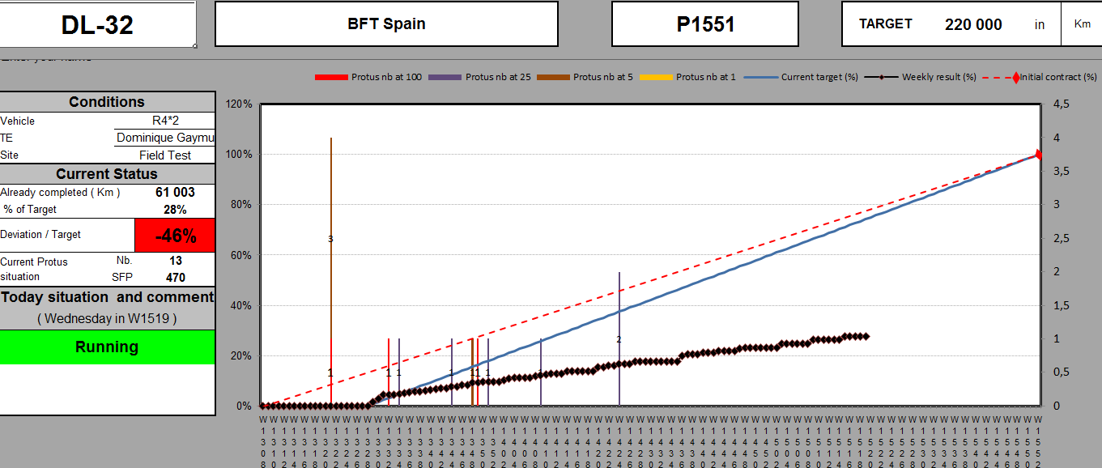
Follow-up
Test Vehicle Viewer

Slide 33
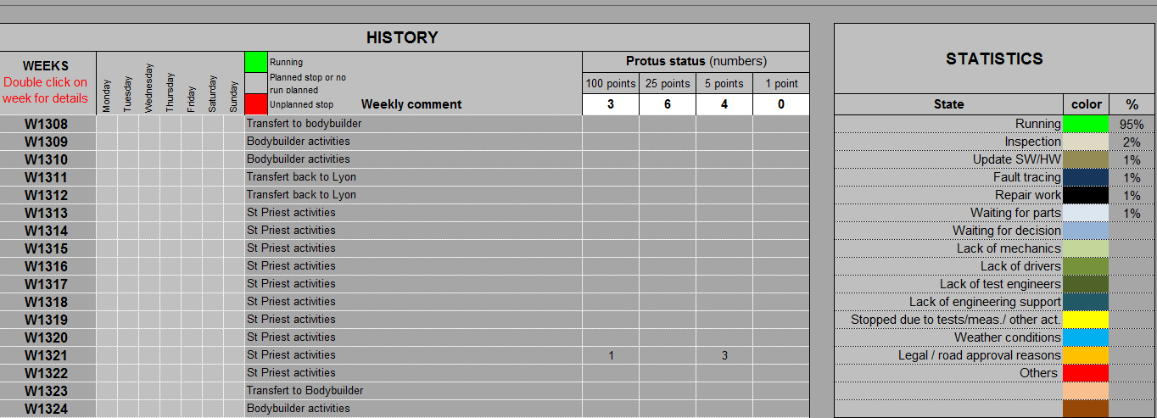
Follow-up
Test Vehicle Viewer

Slide 34
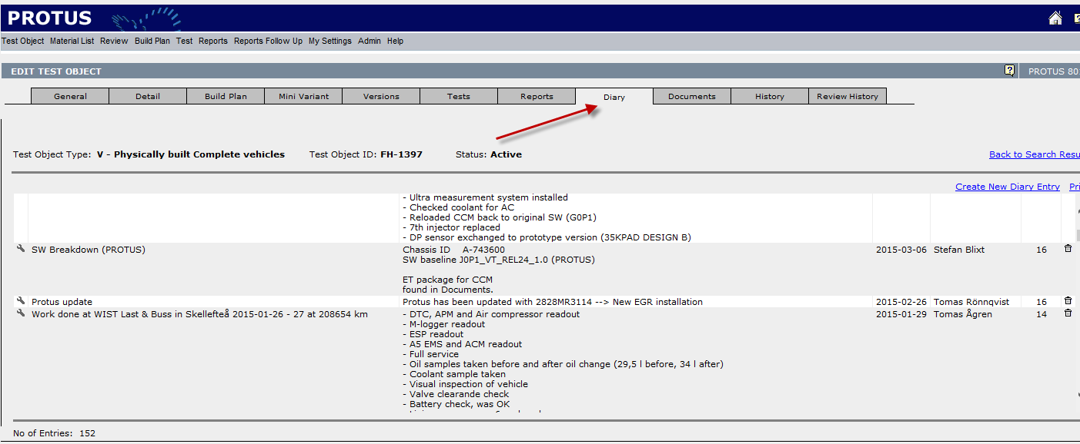
PROTUS – Diary → PROTOM Diary
Follow-up

Slide 35
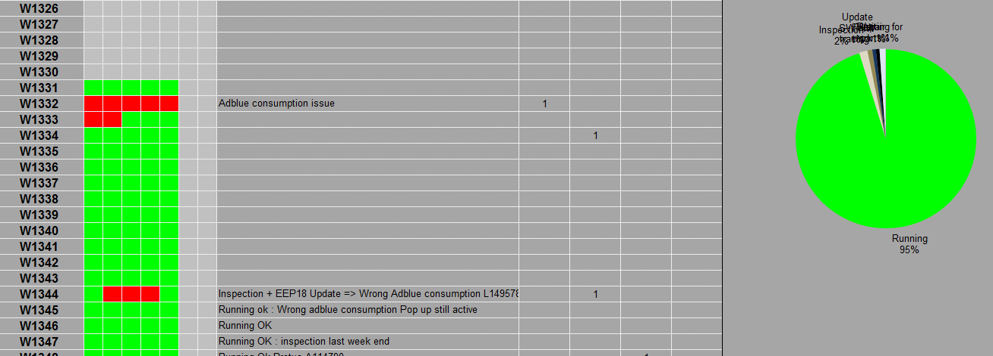
Follow-up
Test Vehicle Viewer

Slide 36
Analyze, Document & Share
Upload of data (STEF, MDA, other)
Write ER reports
Uninstallation and restore vehicle
Reporting
KPI follow-up (e.g. FTT-First Time Through, Request validation time, Request Quotation Time, Late requests, Leadtime, QSI – engineer/technicians)
Actual vs ordered vs planned (e.g. hours, test cases)

Slide 37
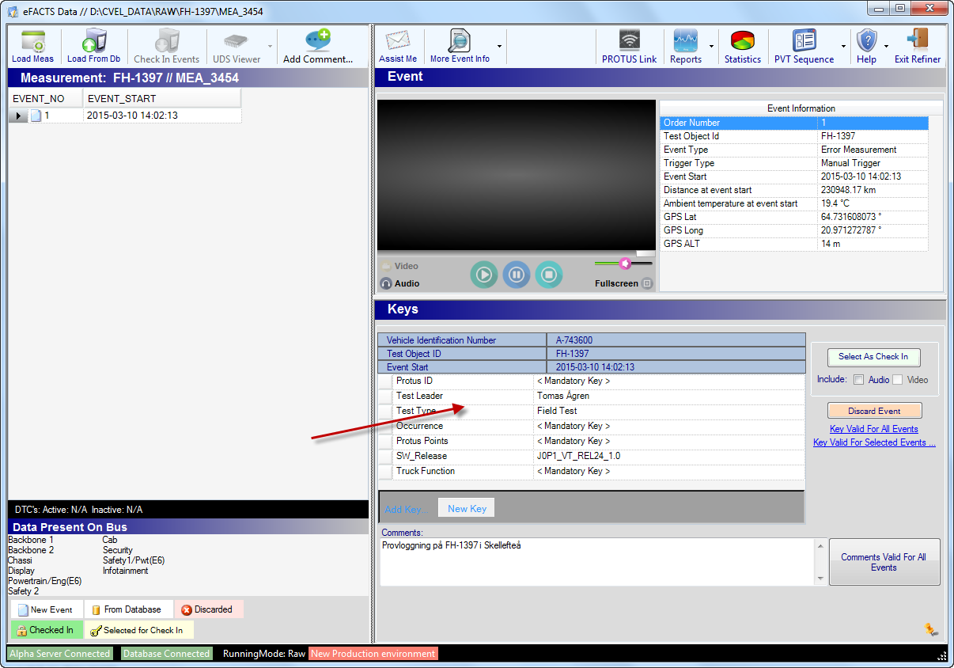
eFACTS
Analyze

Slide 38
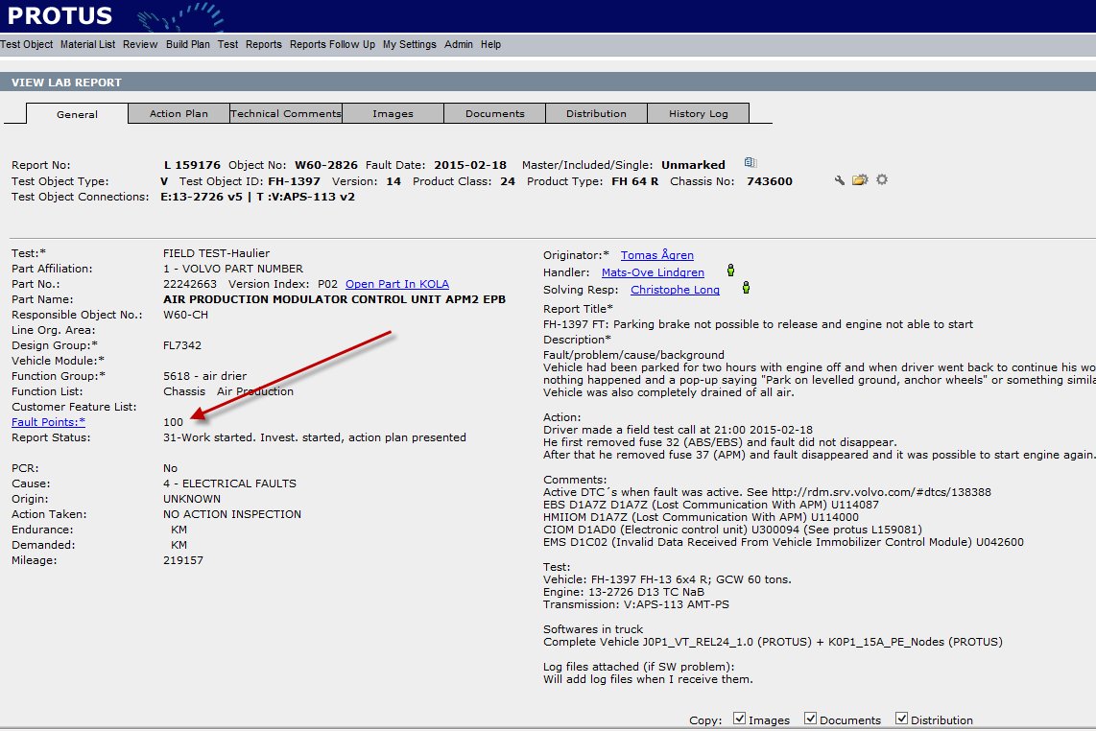
PROTUS
Share

Slide 39
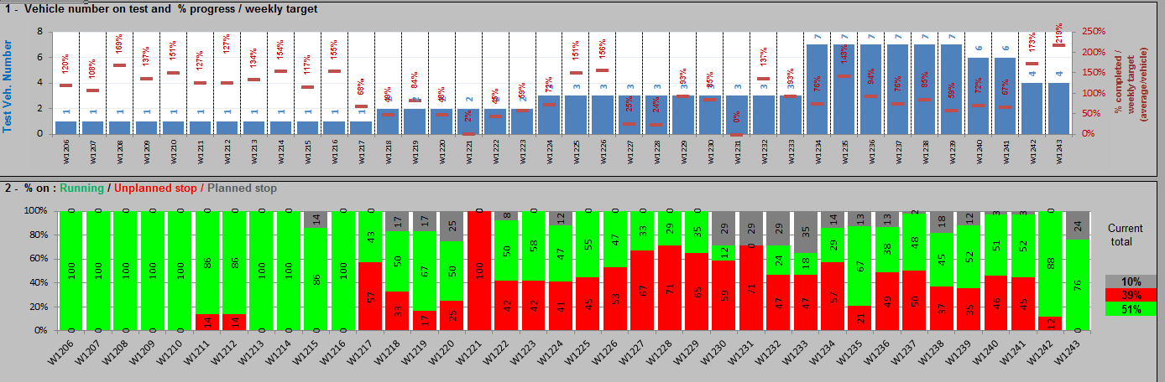
Test finish - reports
Reports

Slide 40
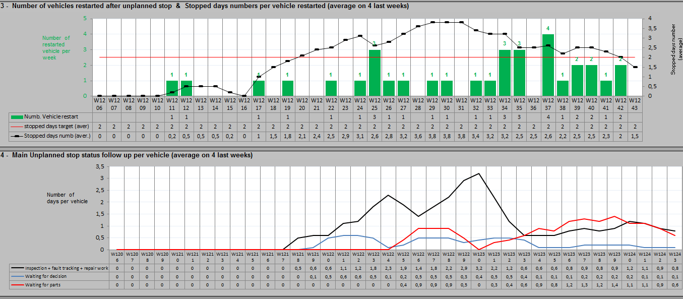
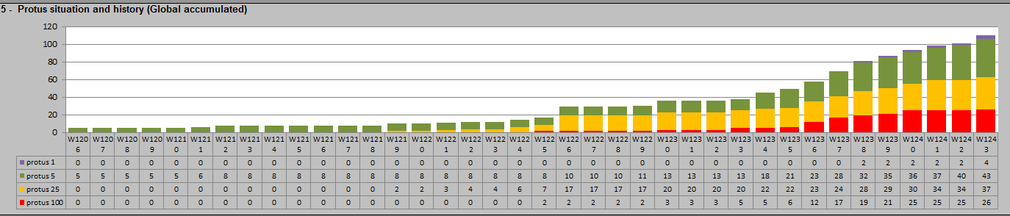
Follow-up

Slide 41
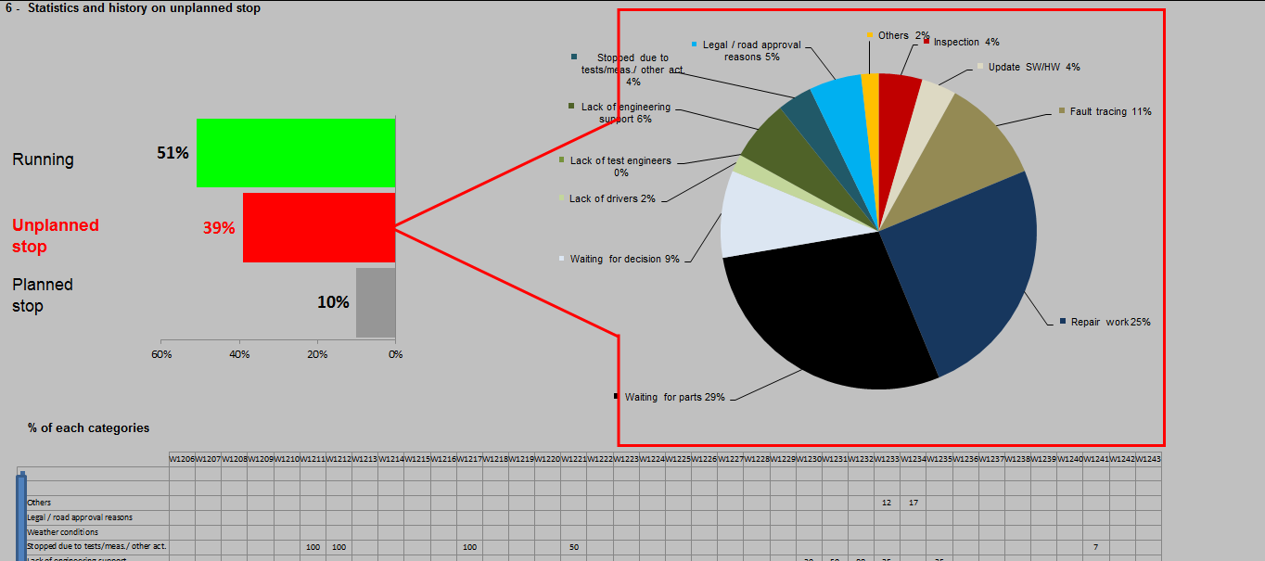
Test finish - reports
Reports

Slide 42
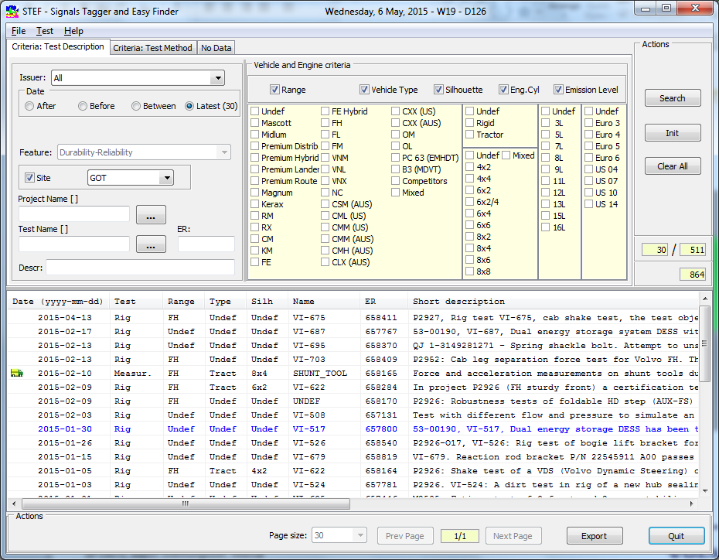
Upload of data – Example STEF
Share

Slide 43
Why need for change?
Missing efficient solution
Changing surrounding
Method continious improvement
More info about test
”EOL” according VIT application review
Test PAD’s for improved efficiency

Slide 44
What projects steps are needed?
Rules how to interact with TCP
Capability mapping, what to include and exclude
Secure work flow process globally
Resources for development and project control

Slide 45
Recommendation – Lesson Learned
Create material for L3 presentation → Martin, Jessica, Axel, Hassan (10/3)
Synchronization with V&V RoadMap → Magnus S/Lars/Ulf/Hassan
Agile work and agile team, approval from L3
Define resources/competence →
IT resources close to business
Enough IT resources for fast progress
Secure that resources from business have time and priority to participate
Clear project scope, plan and delimitations
Small steps will clear objectives
Sweep market for possible COTS solutions
Include small sites early (use role instead of team)

Slide 46
Test Manager Capability - example
Test Cases with variant control
Test Procedure handling supporting each test method
Test Case/Routine/Sequence
Test Execution Interface with PAD/smart phone support
Test Statistics and Reporting
Test Follow-up and Progress (from TCP + Infoboard?
Enabling search for data and tests

